Slide 1
Getting Started with
EMPLOYEE Training

Slide 2
Contents
WELCOME
The Noesis Marketplace
Noesis – Standard Service
Noesis – Premium Service
Lender Portal
Borrower Portal (Coming Soon)
Notes:
[ID:Agenda]

Slide 3
Integrated, Cloud-Based Platform
THE NOESIS MARKETPLACE
Building Equipment Vendors
Building Owners
Lenders
Website for sales proposals with Payment Options
Apply online and get matched up to lender with best terms
See steady flow of deals that match loan criteria

Slide 4
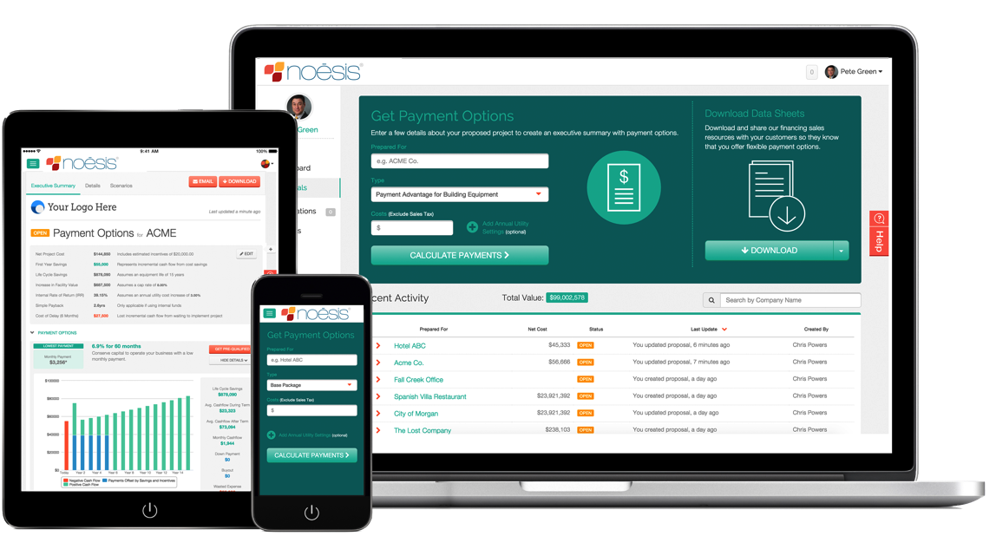
Noesis – Standard Service
What is it?
Our standard service for building equipment vendors includes a single payment package Payment Advantage for Building Equipment. Once registered, vendors log-in to Noesis and calculate monthly payment options, download payment package info sheets, and share online credit applications with customers.
DO NOT USE:
www Base Freemium
Notes:
Make website secondary and service primary

Slide 5
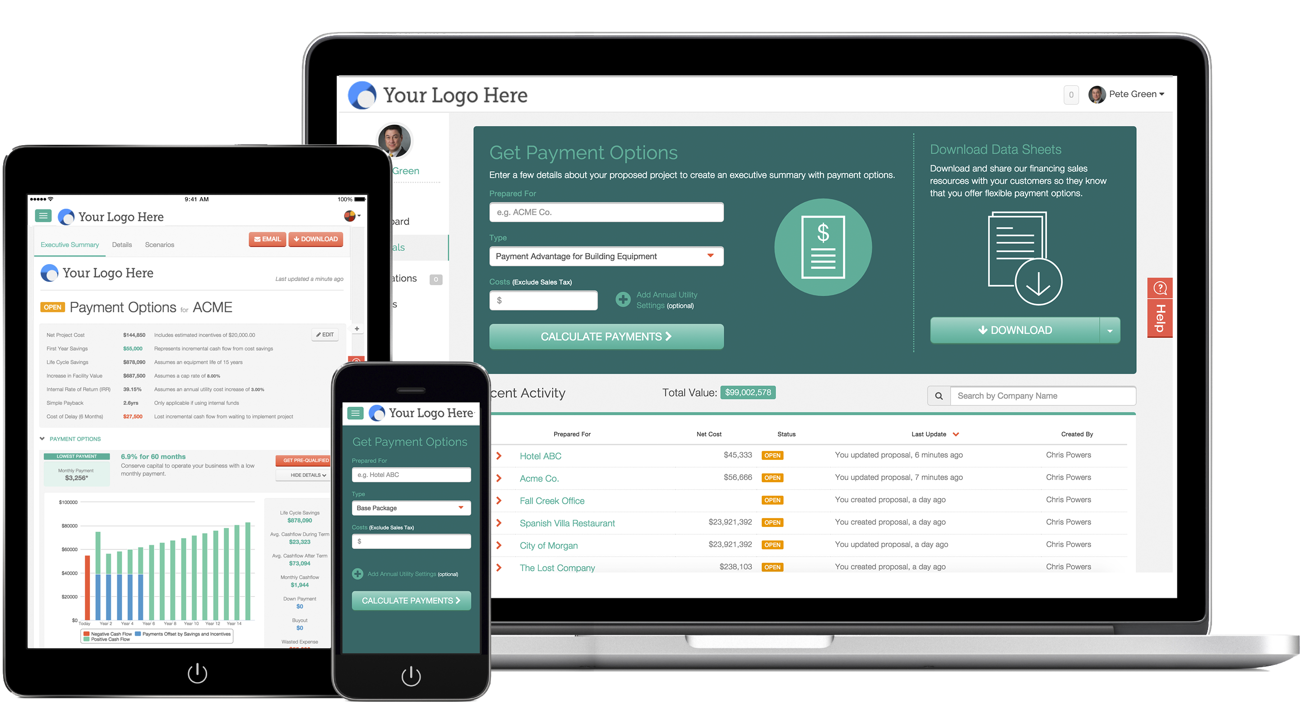
Noesis – Premium Service
What is it?
Our premium service is a customized finance program plan that include payment packages for a specific line of business and sales promotions. Once registered, vendors log-in to their customized website and calculate monthly payment options, download payment package info sheets, and share online credit applications with customers.
DO NOT USE:
Garden White Label Portal

Slide 6
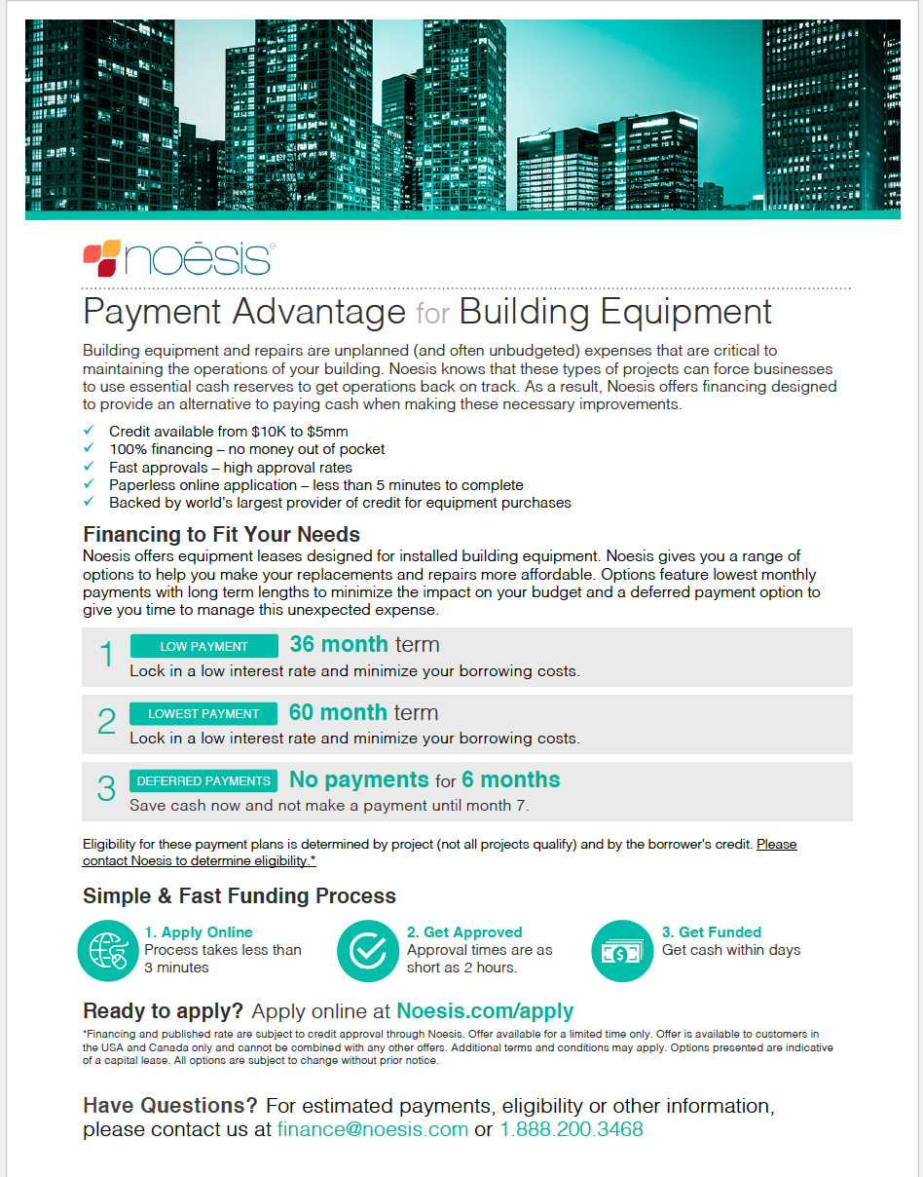
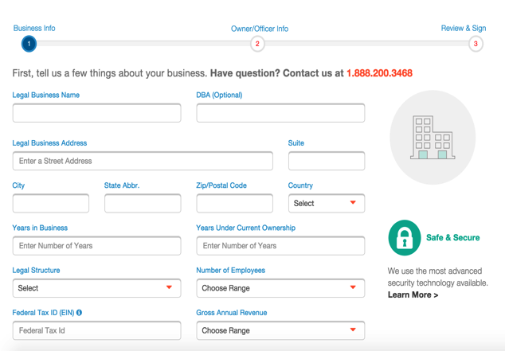
What’s Included Before Credit Submittal
NOESIS PLATFORM
1. Prospect
2. Propose & Present
3. Apply for Credit
Sales Tools
Noesis provides customized sales tools such as the payment package info sheet and badge so you can let your customers know you offer payment options.
DO NOT USE:
Finance Data Sheet (FDS)
Payment Calculator
Enter costs and savings (optional) to get an executive summary that includes our customized monthly payment options and investment analysis. Attach to existing project and share.
DO NOT USE:
Executive Business Case (EBC)
Efficiency Business Proposal (EBP)
One Pager Proposal
Vendor Project Webpage
Where a vendor finds the Payment Calculator, manages projects entered, shares projects with co-workers and customers, shares online credit application.
DO NOT USE:
Developer Portal
Customer Project Webpage
SAVINGS ONLY Follow-up by emailing your customer an online version of the investment analysis. Your customer can compare cash flows of different payment options and apply for credit through the online credit application.
DO NOT USE:
Borrower Landing Page
3rd Party Investment Analysis
SAVINGS ONLY Optionally, Noesis can present our detailed investment analysis alongside you and your customer.
DO NOT USE: 3IA
Project Pipeline Dashboard
VENDOR MANAGEMENT ONLY The dashboard used to display the status of their company’s projects. Includes statuses such as Credit Not Submitted, Final Costs Needed, Credit Submitted, Credit Approved, Credit Rejected.
DO NOT USE:
VP Dashboard
Admin View
Online Credit Application
Once your customer shows interest in payment options, email the online credit application. The application takes 3 minutes and approval times are within 48 hours.
DO NOT USE:
Financing App
Notes:
Do we need to include Standard vs Base Credit Project Package, Credit Products Project Pipeline Dashboard, 3IA, Approved Credit Terms Email, Final Cost Breakdown?
----- Meeting Notes (2/22/16 09:43) -----
Sales Tools
Payment Packages > Payment Options
----- Meeting Notes (2/22/16 10:05) -----
Move Follow-up into second step Present and add 3IA
Customer Project Webpage

Slide 7
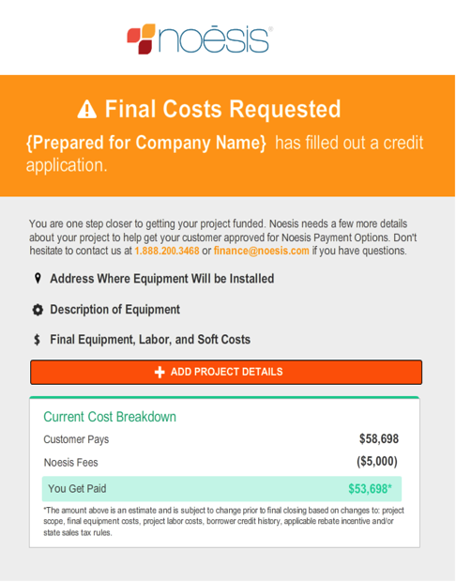
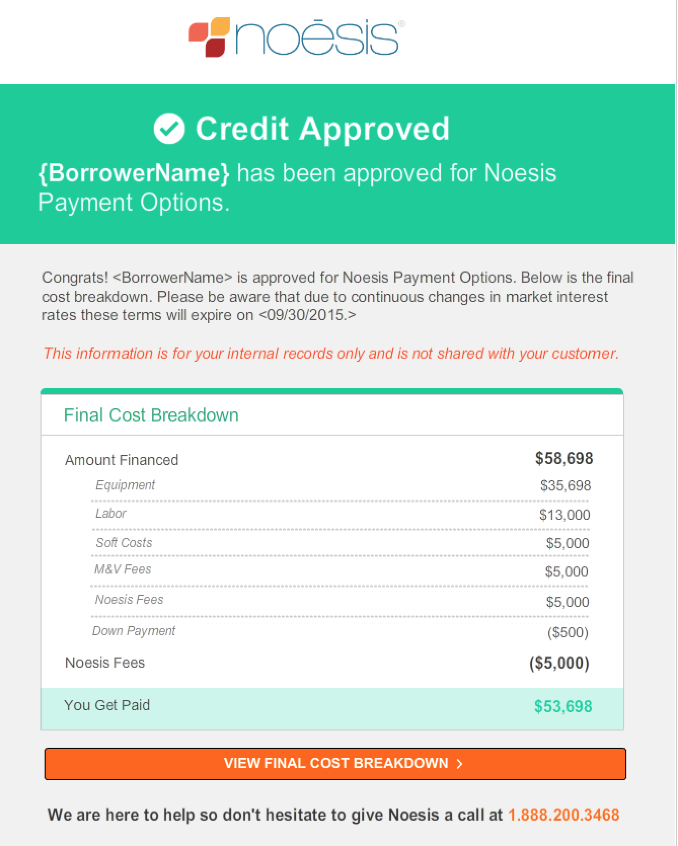
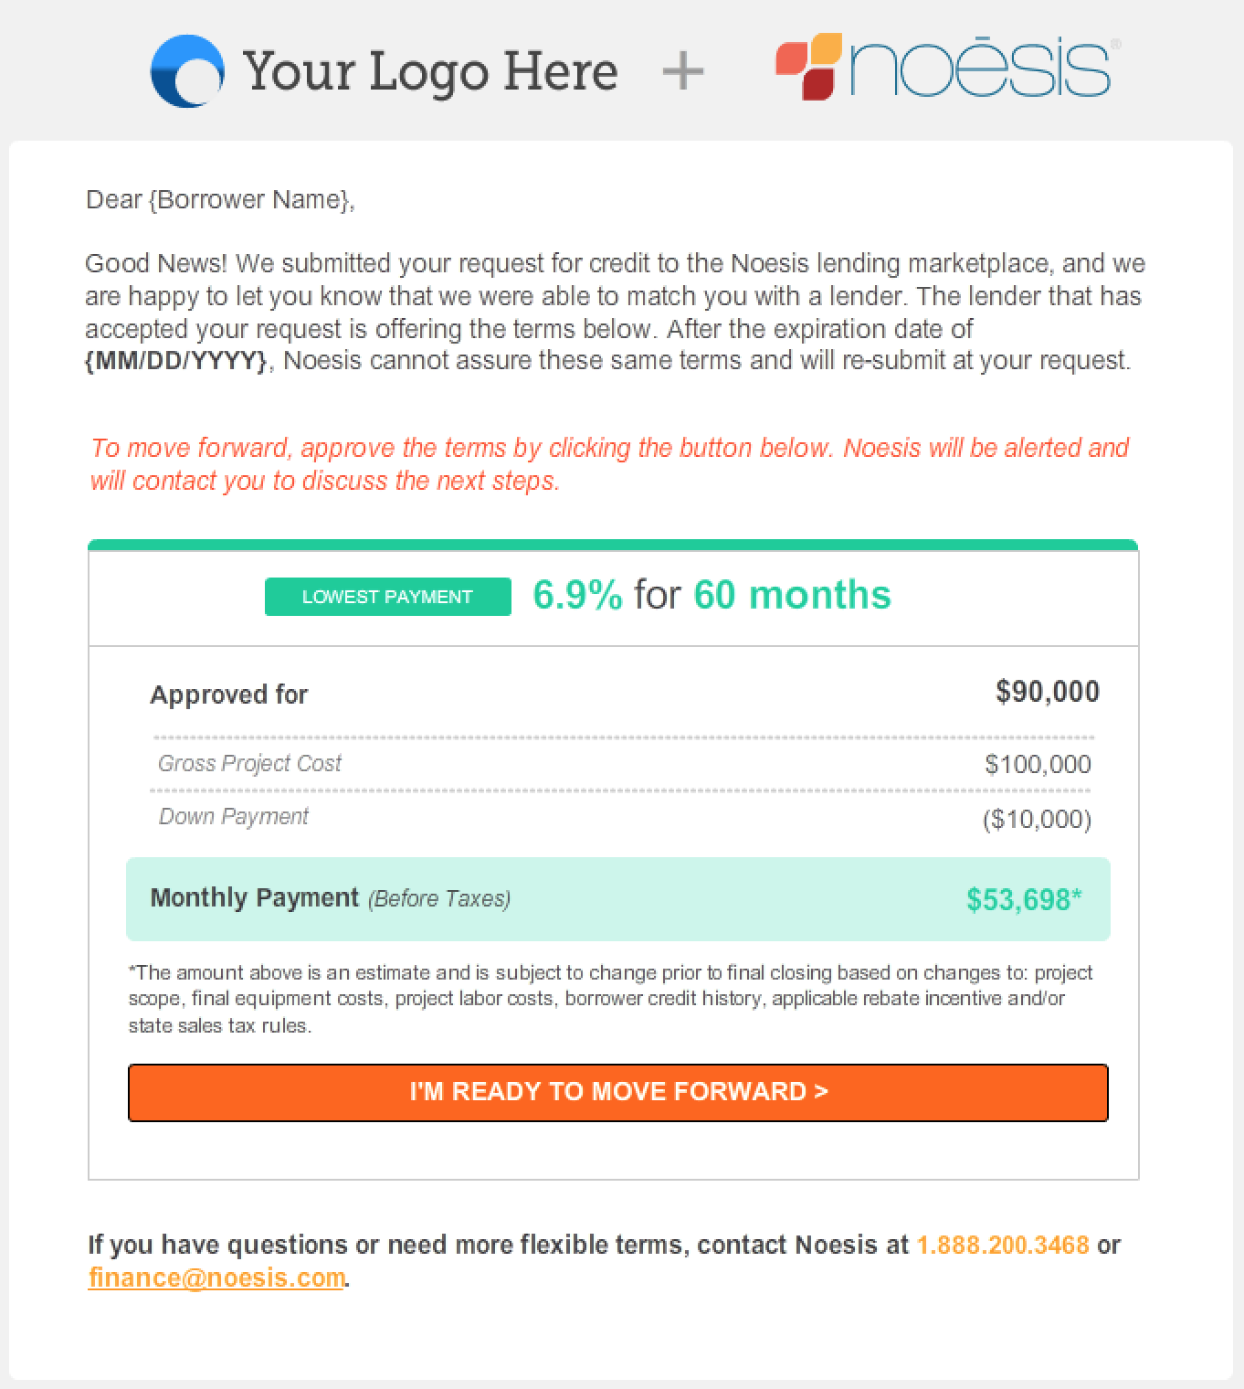
What’s Included After Credit Submittal
NOESIS PLATFORM
4. Credit Submitted
5. Credit Approved
6. Borrower Matched
To Vendor
Once credit is submitted, an email is sent requesting the final project costs.
To Vendor
Once final costs are entered and credit team works with lenders to approve the credit, an email with the Final Cost Breakdown is sent the vendor.
To Borrower (COMING SOON)
Once final costs are entered and credit team works with lenders to approve the credit, an email of Approved Payment Terms is sent to borrower.
Notes:
Do we need to include Standard vs Base Credit Project Package, Credit Products Project Pipeline Dashboard, 3IA, Approved Credit Terms Email, Final Cost Breakdown?

Slide 8
Standard vs. Premium
NOESIS PLATFORM
 | Standard | Premium
Standard Payment Package (Payment Advantage for Building Equipment) | ✓ | ✓
Premium Payment Packages (Promotional Financing, Muni, Cannabis) |  | ✓
Finance Program Plan (Customized training program that aligns to business goals and sales promotions) |  | ✓
Branded Website |  | ✓
Executive Summary with Investment Analysis (Annual Utility Savings, Itemized Measures Scenarios) |  | ✓
Executive Summary | ✓ | ✓
Pre-Funding |  | ✓
Sales & Training Support |  | ✓
Third Party Investment Analysis |  | ✓
Notes:
This slide is primar

Slide 9
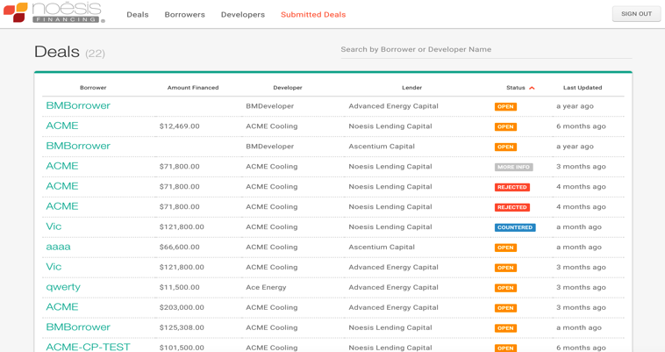
Lender Portal
What is it?
An underwriting web application in which the Noesis Credit Team members interact with a marketplace of lending partners once a credit application is submitted. In underwriting, the credit team submits a deal to lender that includes the Noesis credit score, financial docs, and recommended terms with the lender to quickly negotiate and approve or reject deals.
DO NOT USE:
 Lending Portal

Slide 10
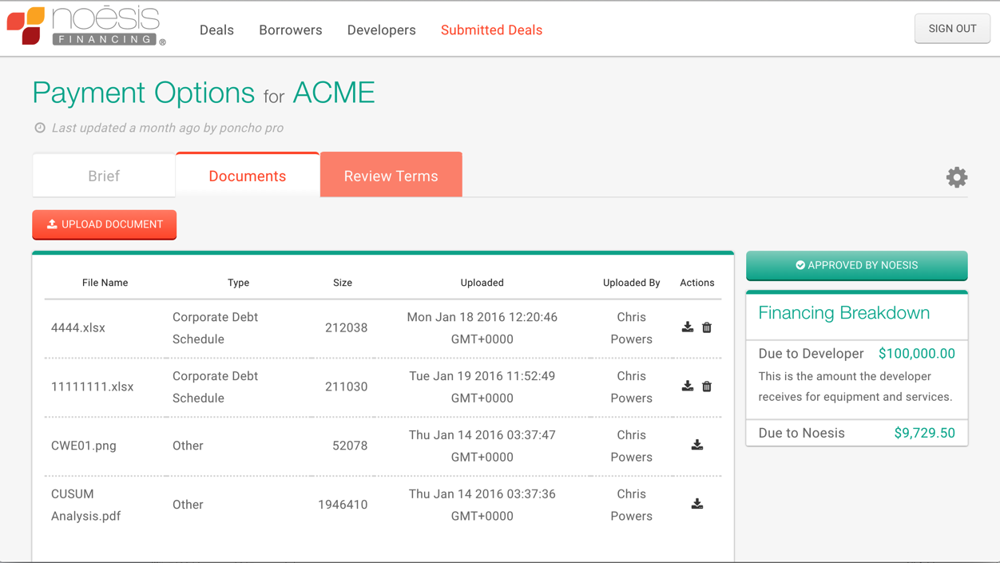
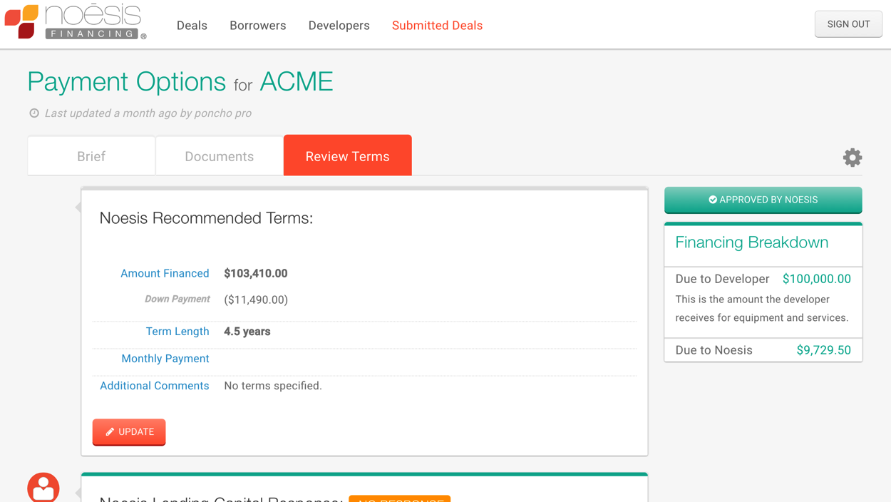
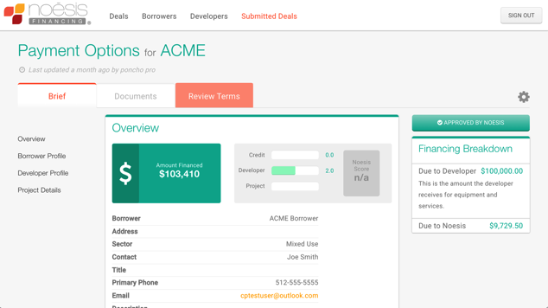
What’s Included in a Submitted Deal
LENDER PORTAL
1. Deal Brief
2. Documents
3. Recommended Terms
The deal brief includes an overview of Noesis credit analysis & score, borrower profile, developer profile and project details.
Lenders and Noesis credit team securely share financial and project documents.
Once Noesis does the initial credit analysis and collects required financial docs, the deal is submitted to a lender that is the best match with the borrower. The submitted deal comes with recommended terms based on our custom credit products. The deal is negotiated until final terms are approved or rejected.
DO NOT USE:
 RFQ

Slide 11
Borrower Portal (Coming Soon)
What is it?
A secure portal that allows the Noesis credit team to request, track, and collect documents from the borrower.

